Slide 1

TIER-Plus overview and core functionality
Brooke Nichols, Boston University Prioritization under pressure: Rethinking HIV service delivery with TIER-Plus

Slide 2
Who is TIER-Plus for?

Slide 3

Let’s take a look
ORIENTATION
INPUTS (country & coverage)
SCENARIOS (adjust interventions)
4. OUTPUTS (costs + outcomes + cascades)

Slide 4
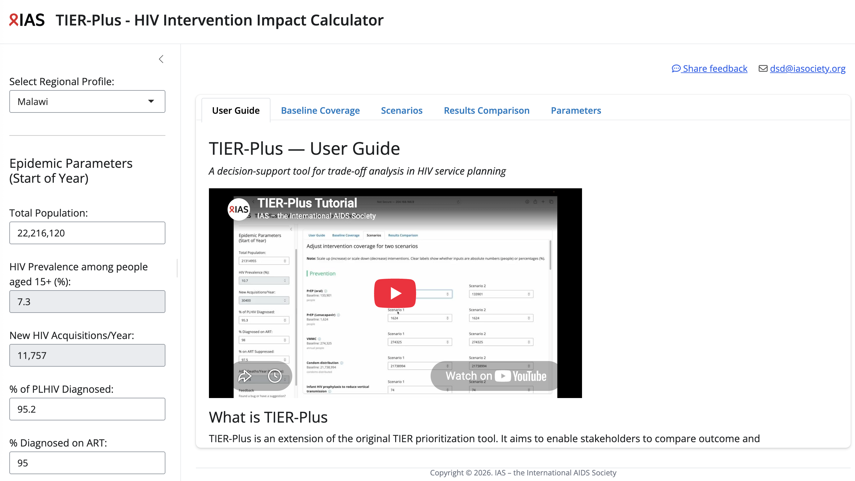
Orientation
Notes:
Let me orient you to what you’ll see when you open TIER-plus. I recognise it might not look identical to you if you’re opening with your phone (see QR code on bottom right).
First, if you leave this room forgetting everything- let me start by showing you where to find the user guide- a 7 minute youtube video smackdab in the middle of the opening screen. Then (second pop up) there is some information telling you what each sheet and parameter means- so if you get lost, you can always navigate back.
3. If you have feedback- if something isn’t working, or you think the results are not making sense, or you want something that is not listed- please share your feedback with this feedback form, or by emailing (4) this address.
Note- this screenshot will be updated

Slide 5
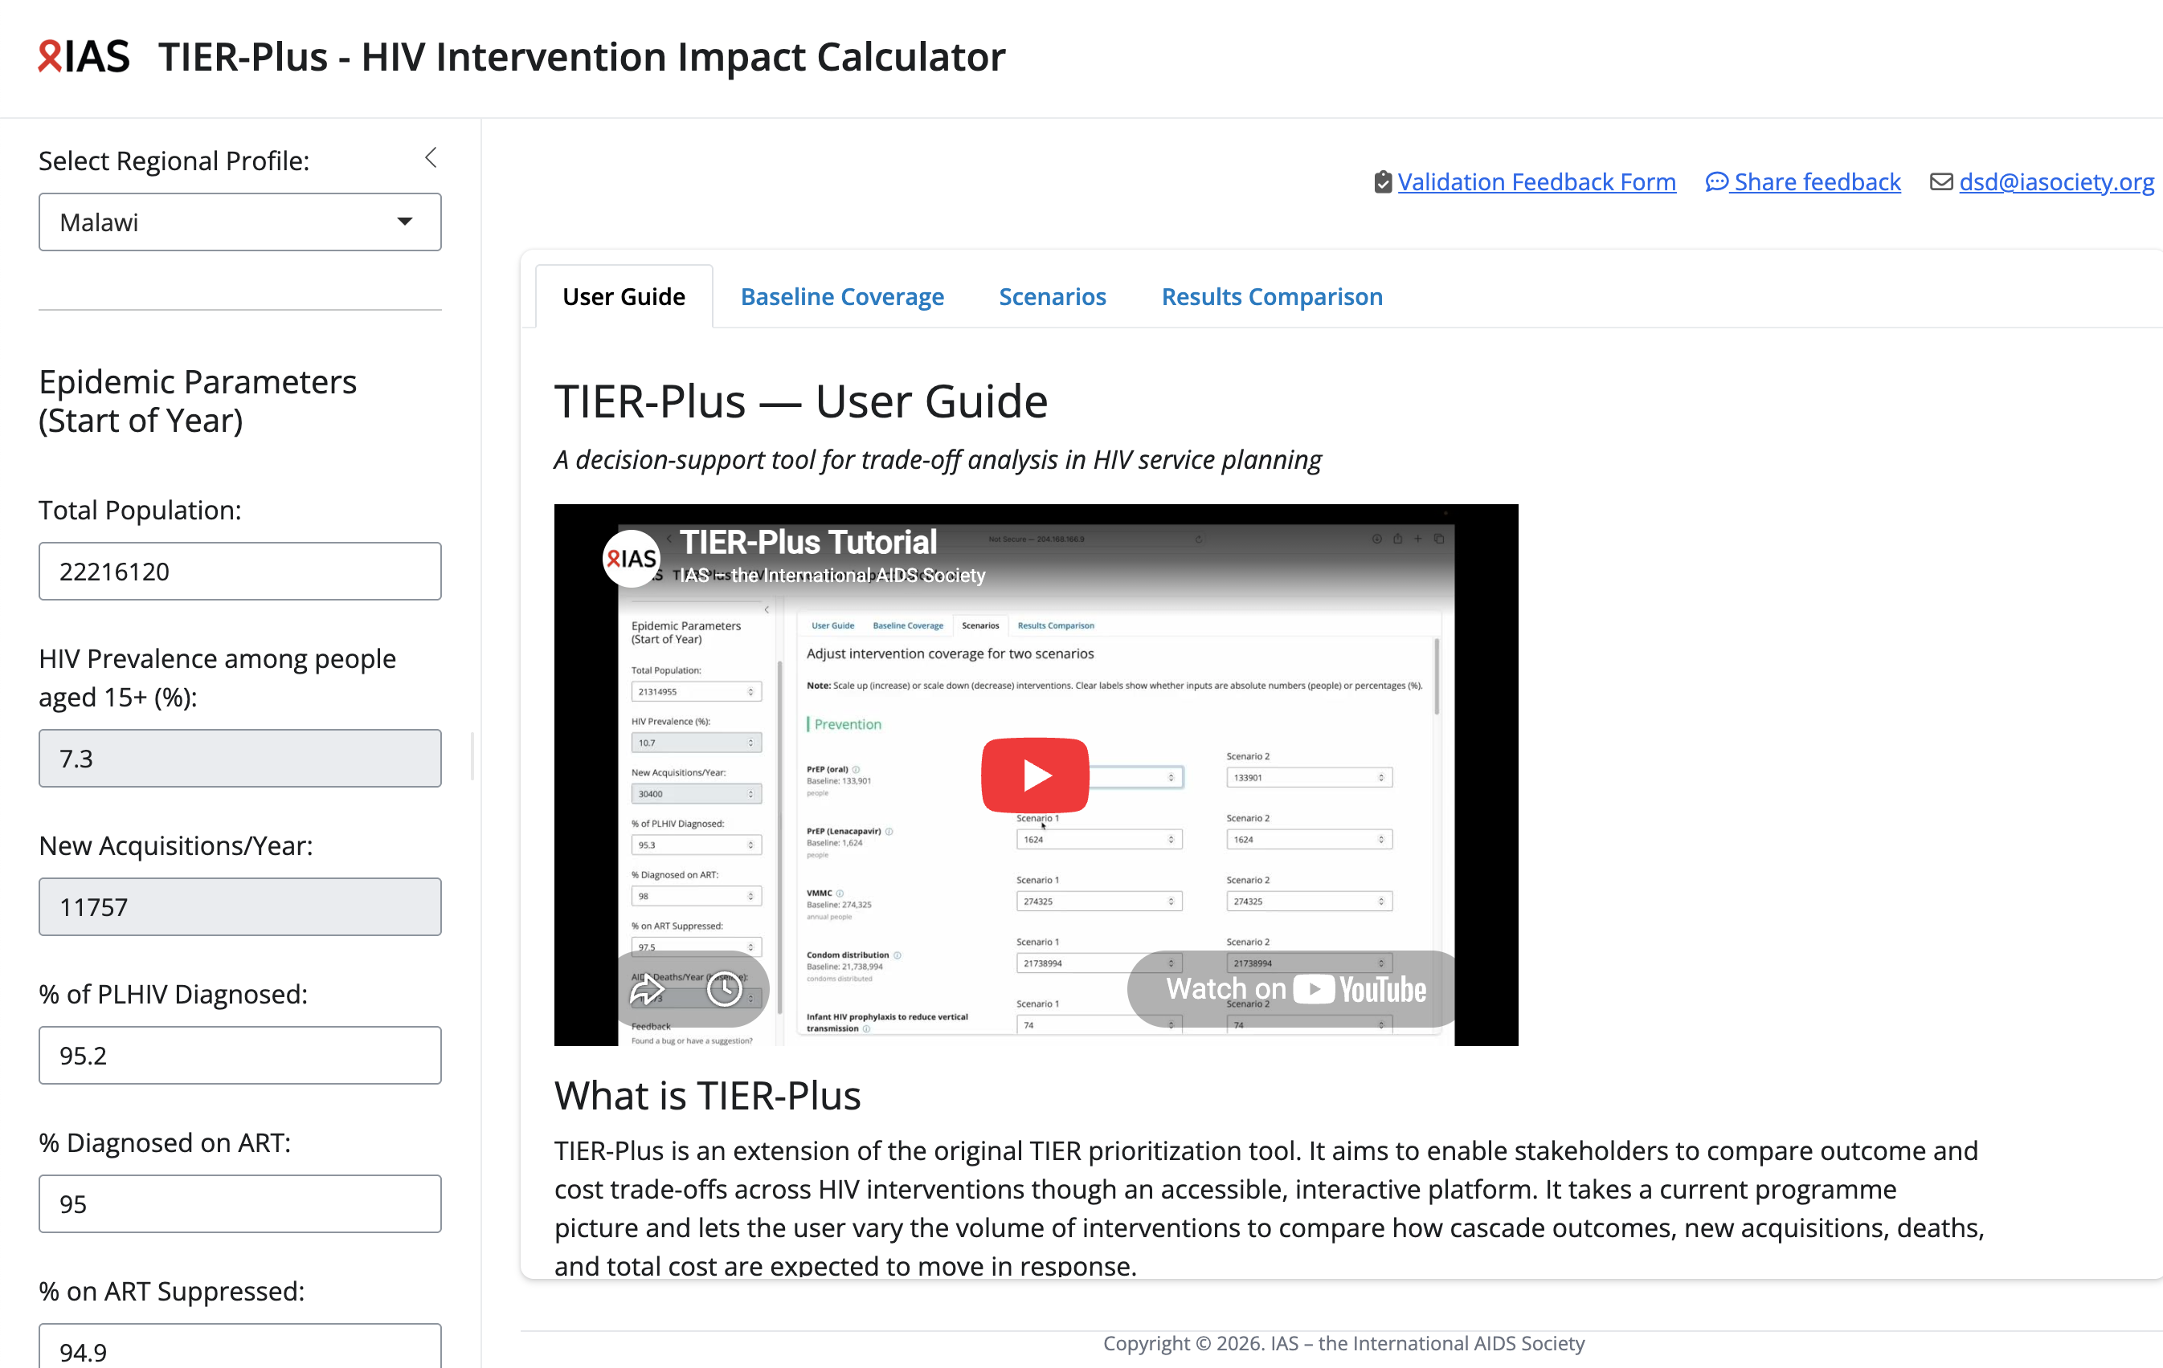
What goes in (inputs 1)
Select the country
Confirm (or edit) epidemic parameters (greyed out cannot be modified)

Slide 6
Notes:
Let me orient you to what you’ll see when you open TIER-plus. I recognise it might not look identical to you if you’re opening with your phone (see QR code on bottom right).
First, if you leave this room forgetting everything- let me start by showing you where to find the user guide- a 7 minute youtube video smackdab in the middle of the opening screen. Then (second pop up) there is some information telling you what each sheet and parameter means- so if you get lost, you can always navigate back.
3. If you have feedback- if something isn’t working, or you think the results are not making sense, or you want something that is not listed- please share your feedback with this feedback form, or by emailing (4) this address.
Note- this screenshot will be updated

Slide 7
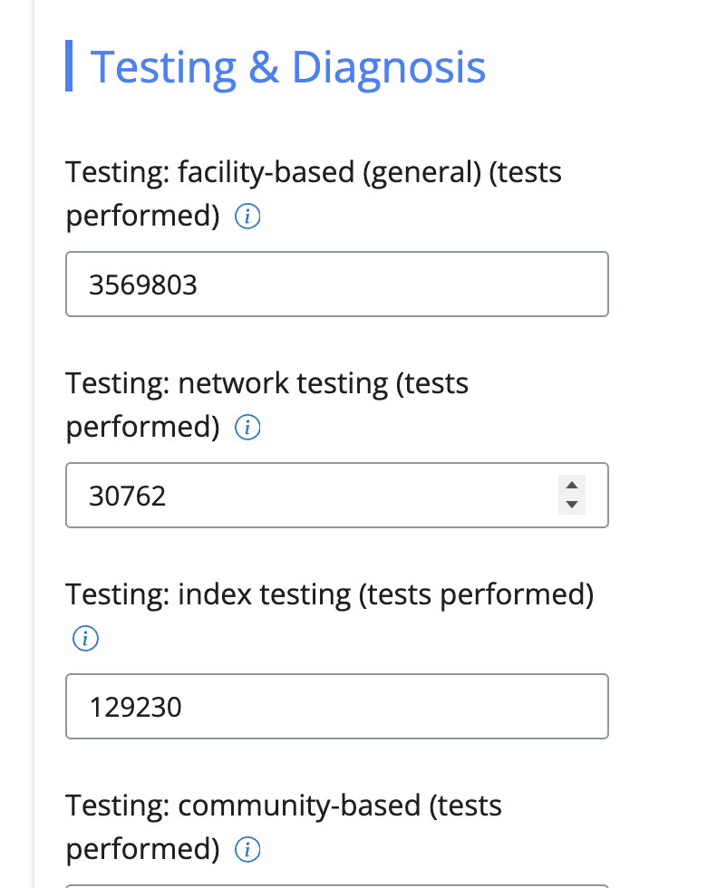
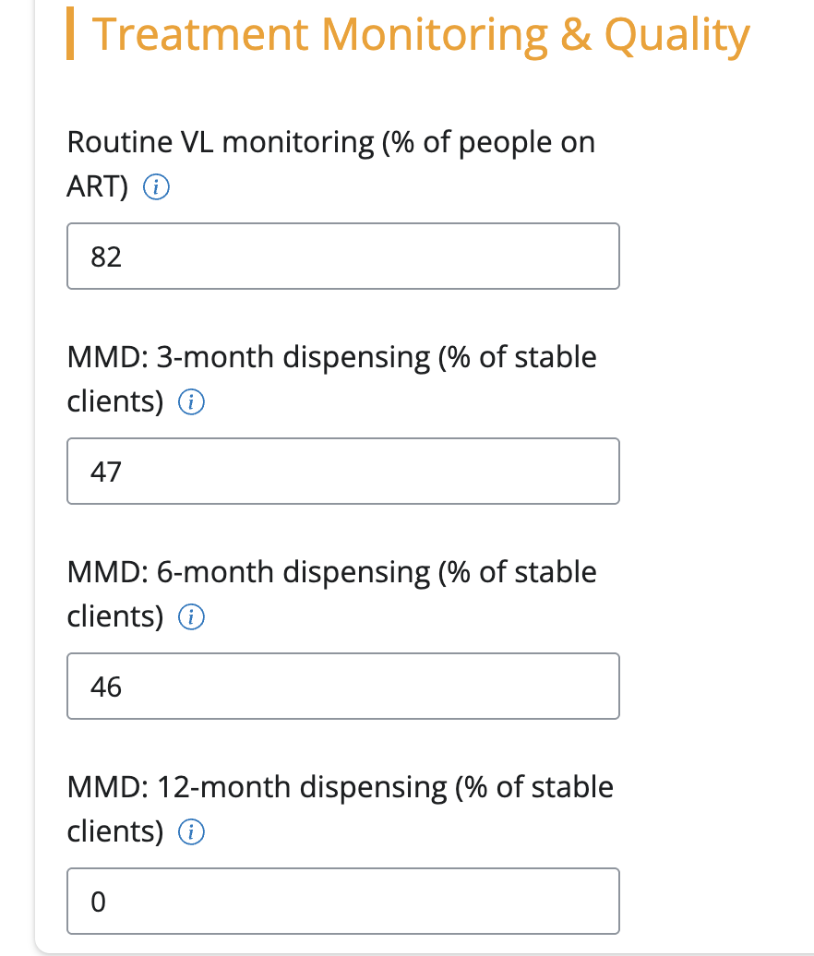
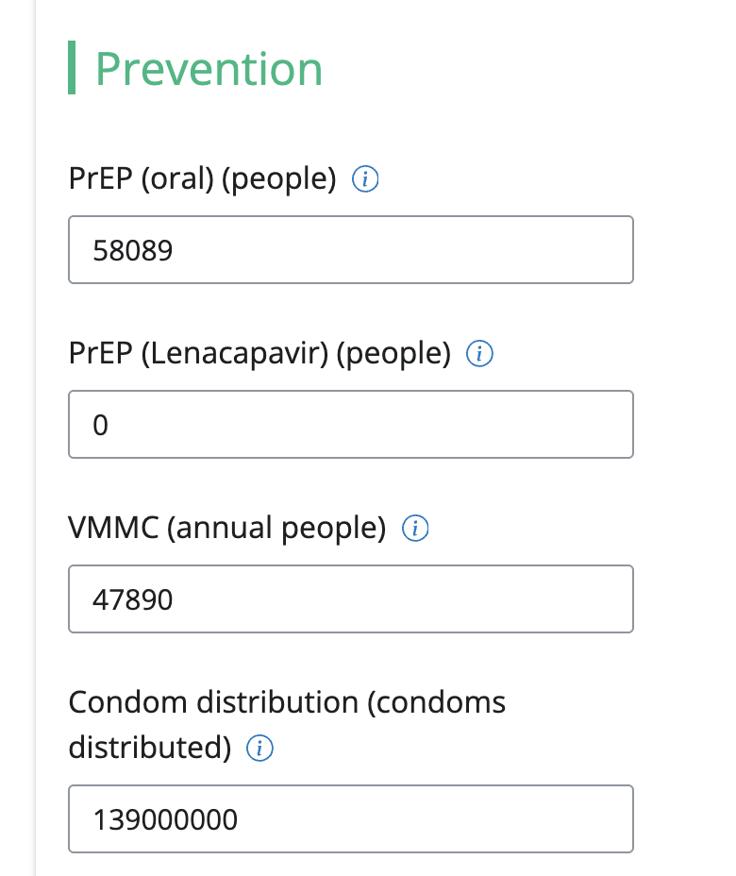
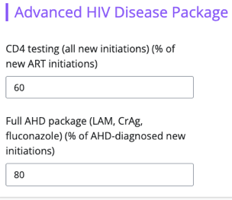
What goes in (inputs 2)
c. Baseline interventions (coverage)
For prevention
For testing and diagnosis
For treatment monitoring and quality
For retention and adherence support
For advanced HIV disease
Important note!
Default data is provided → Users can customize if better national data are available.

Slide 8
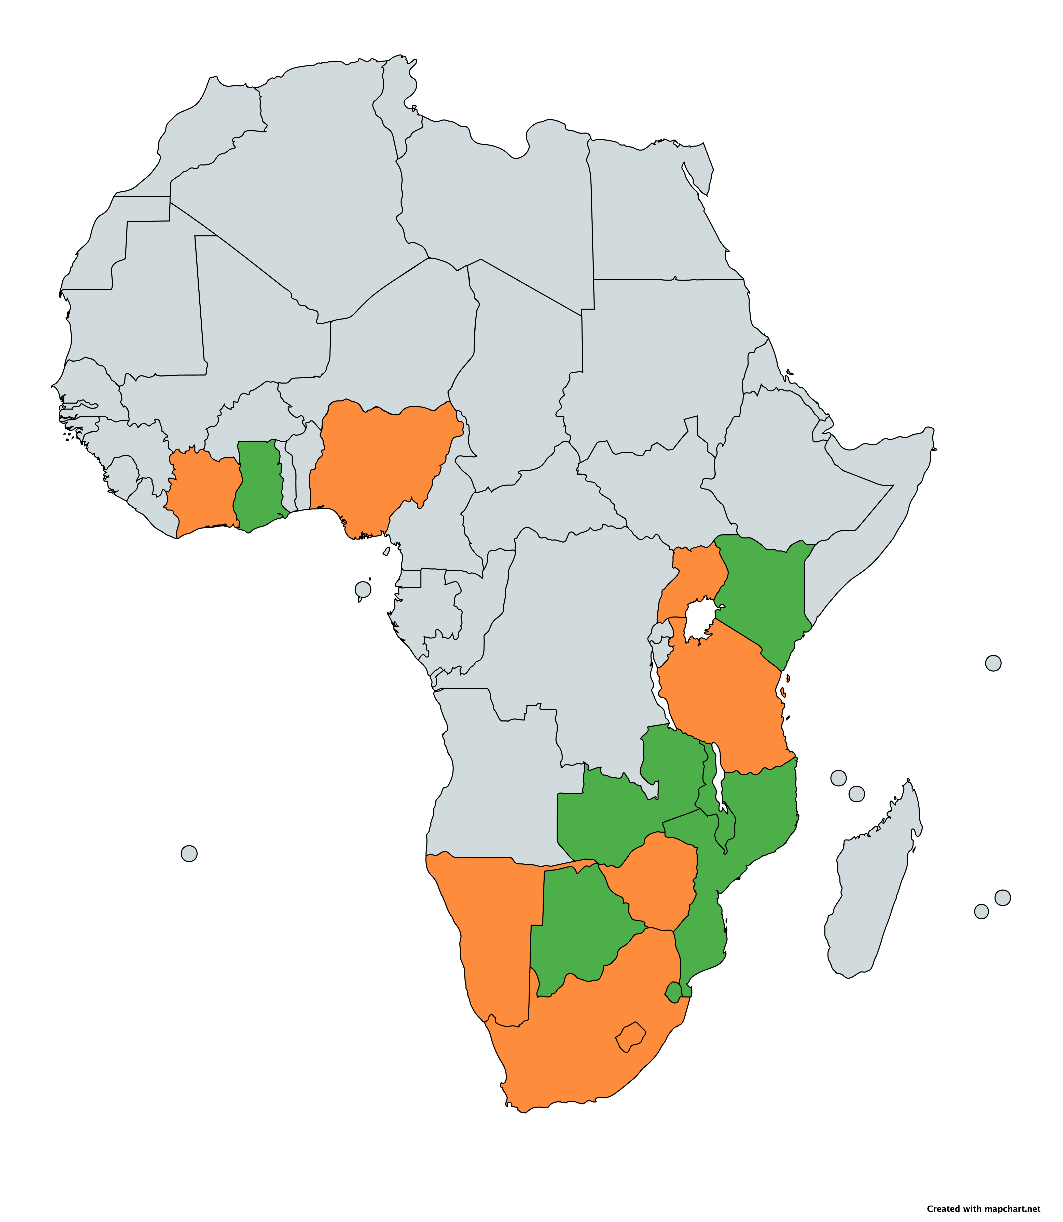
Uganda
Countries represented in TIER-Plus
Côte d’Ivoire
Ghana
Nigeria
Kenya
Baseline data values reviewed and updated by in-country teams
Tanzania
Malawi
Zambia
Baseline data values from publicly available resources and literature
Namibia
Mozambique
Zimbabwe
South Africa
Eswatini
Lesotho

Slide 9
Notes:
Let me orient you to what you’ll see when you open TIER-plus. I recognise it might not look identical to you if you’re opening with your phone (see QR code on bottom right).
First, if you leave this room forgetting everything- let me start by showing you where to find the user guide- a 7 minute youtube video smackdab in the middle of the opening screen. Then (second pop up) there is some information telling you what each sheet and parameter means- so if you get lost, you can always navigate back.
3. If you have feedback- if something isn’t working, or you think the results are not making sense, or you want something that is not listed- please share your feedback with this feedback form, or by emailing (4) this address.
Note- this screenshot will be updated

Slide 10

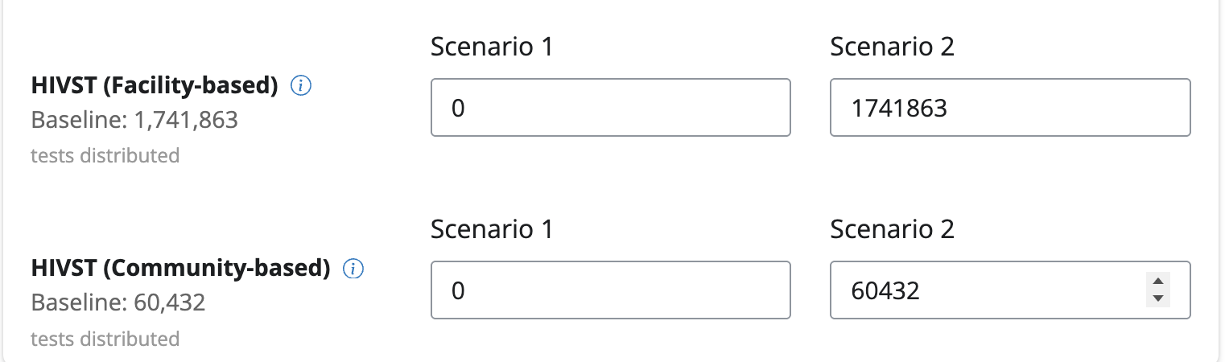
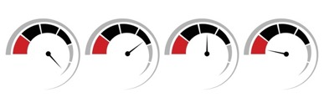
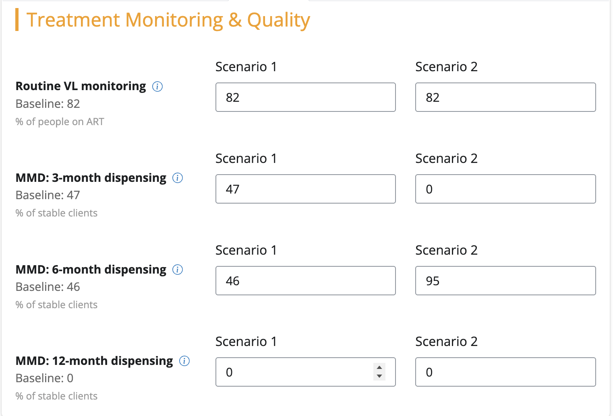
Then it’s time to play – or build scenarios
For example:
Scenario 1: No self-testing
Scenario 2: more 6MMD
Adapt the coverage of different interventions (populate different scenarios for comparison)
Add more interventions, and/or take some away
With this information, more and less of different interventions, TIER-Plus can then compare the impact on costs and outcomes

Slide 11
Notes:
Let me orient you to what you’ll see when you open TIER-plus. I recognise it might not look identical to you if you’re opening with your phone (see QR code on bottom right).
First, if you leave this room forgetting everything- let me start by showing you where to find the user guide- a 7 minute youtube video smackdab in the middle of the opening screen. Then (second pop up) there is some information telling you what each sheet and parameter means- so if you get lost, you can always navigate back.
3. If you have feedback- if something isn’t working, or you think the results are not making sense, or you want something that is not listed- please share your feedback with this feedback form, or by emailing (4) this address.
Note- this screenshot will be updated

Slide 12
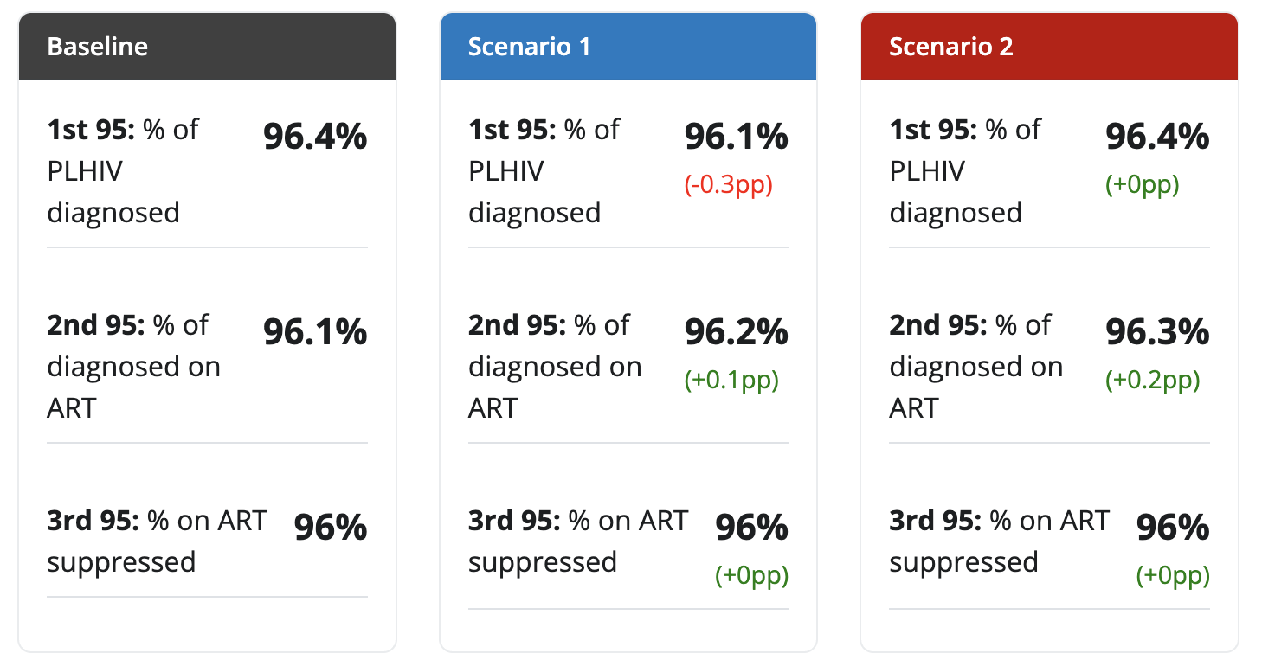
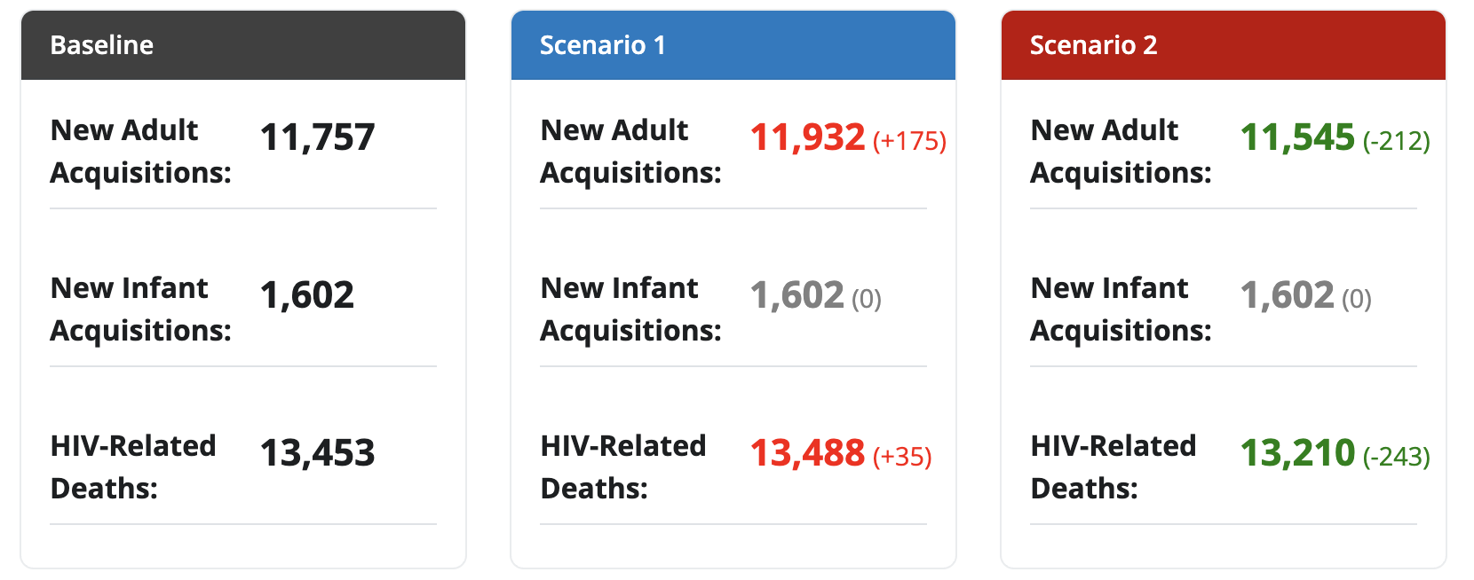
What TIER-Plus produces (outputs) 1/3
→ Two scenarios compared to the baseline
1-year outputs
a. Progress towards 95-95-95s
b. Key epidemiological outcomes

Slide 13
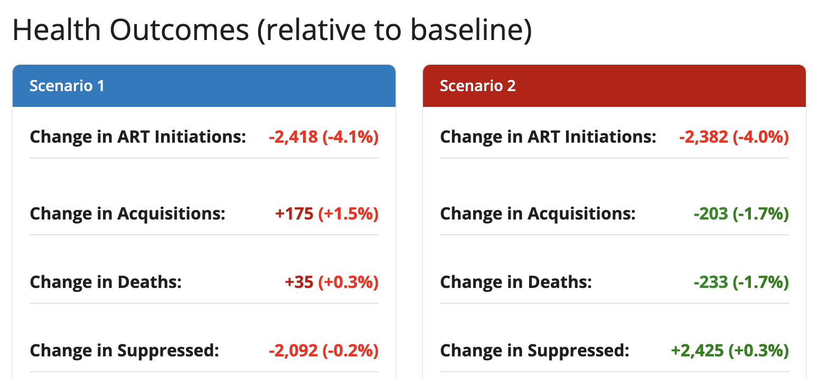
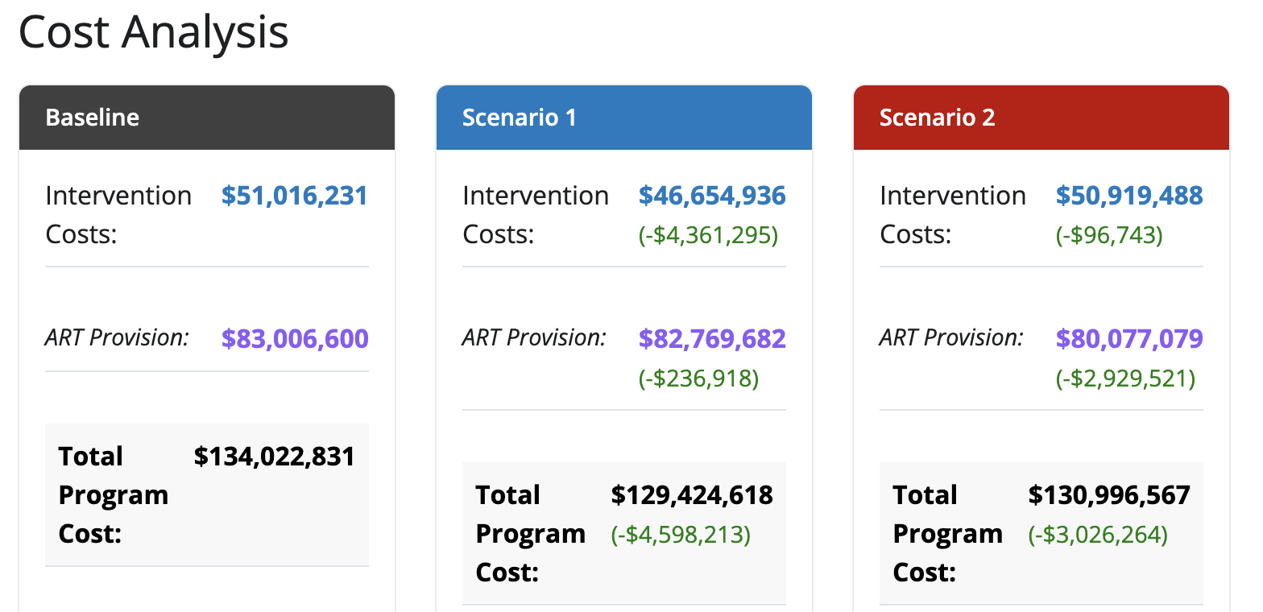
What TIER-Plus produces (outputs) 2/3
c. Health outcomes
d. Cost analysis
Notes:
To be updated with cost breakdown graph

Slide 14
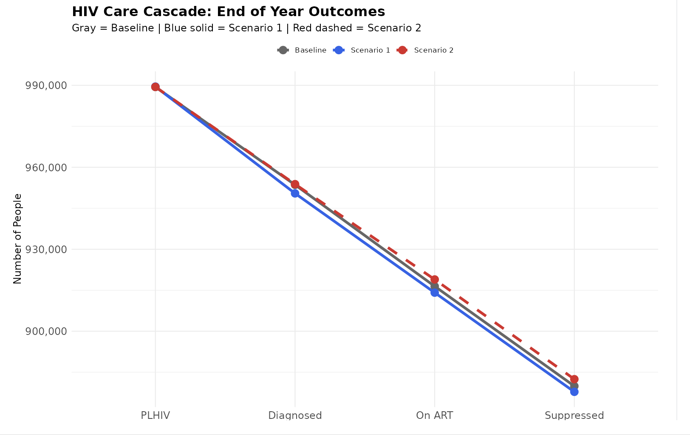
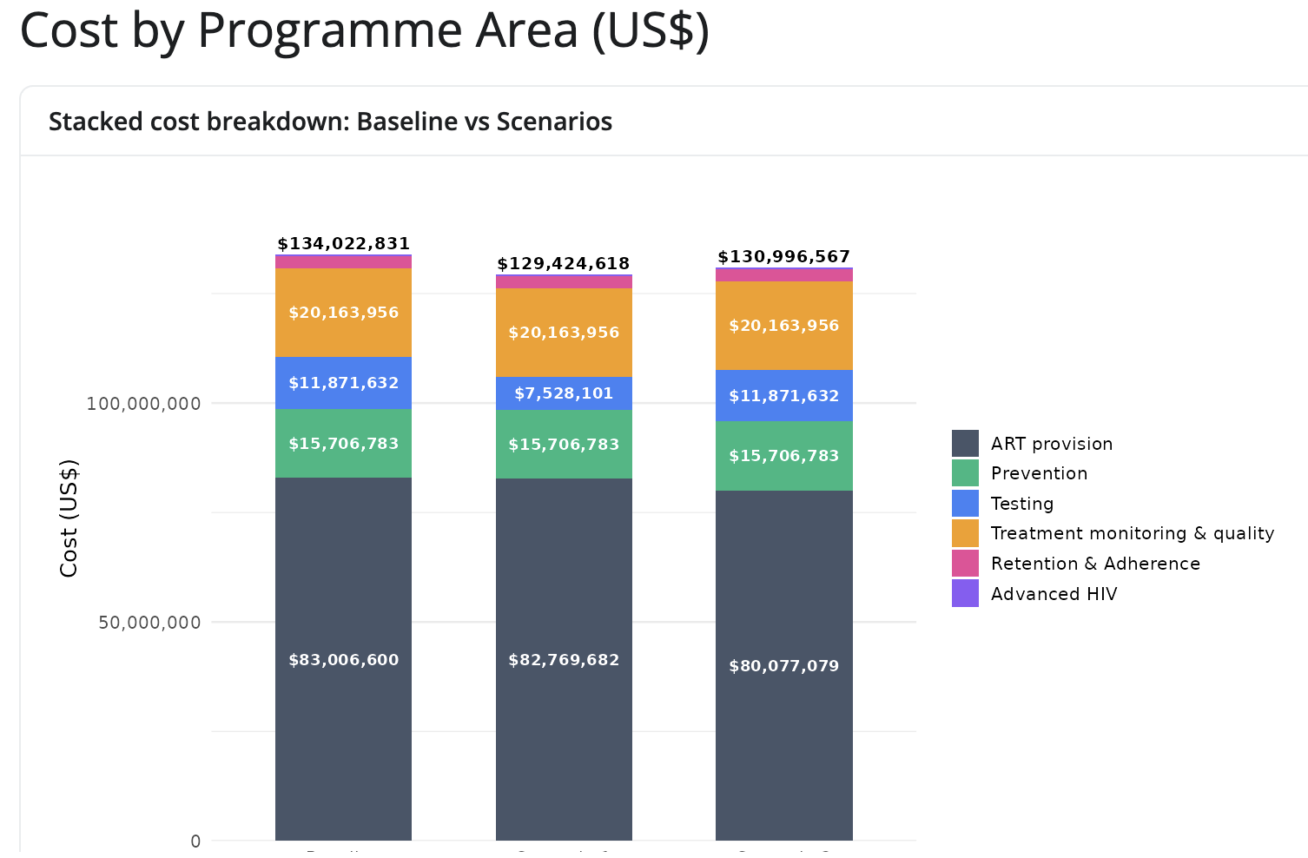
What TIER-Plus produces (outputs) 3/3
e. Impact on HIV care cascade
f. Cost breakdown

Slide 15
Notes:
Let me orient you to what you’ll see when you open TIER-plus. I recognise it might not look identical to you if you’re opening with your phone (see QR code on bottom right).
First, if you leave this room forgetting everything- let me start by showing you where to find the user guide- a 7 minute youtube video smackdab in the middle of the opening screen. Then (second pop up) there is some information telling you what each sheet and parameter means- so if you get lost, you can always navigate back.
3. If you have feedback- if something isn’t working, or you think the results are not making sense, or you want something that is not listed- please share your feedback with this feedback form, or by emailing (4) this address.
Note- this screenshot will be updated

Slide 16
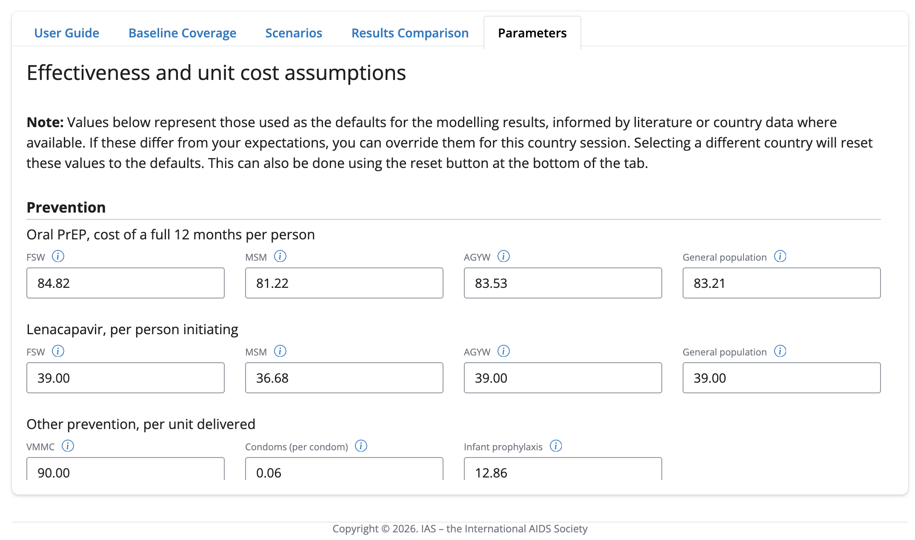
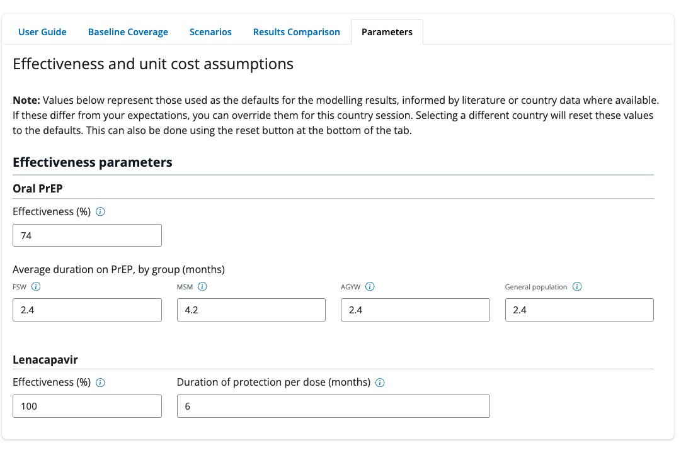
What if you want to adjust the assumptions?

Slide 17
✅ What TIER-Plus can do
❌ What TIER-Plus cannot do
✅ Support decision making conversations at a national level
✅ Look at the impact across the cascade of multiple interventions
✅ Give an understanding of relative impact of different interventions on both outcomes and cost
❌ Provide exact cost estimates for budgeting
❌ Give long-term estimates on epidemic impact
❌ Replace intervention-specific planning (use DMPPT, PrEP-it, etc.)
❌ INTEGRATION

Slide 18
The piloting phase
The piloting phase has resulted in several meaningful changes:
Feedback | Completed
PrEP targeting by sub-population
Updated costs
Output including cost breakdown by category of costs
Inclusion of 6-monthly clinical visits vs 12- monthly clinical visits
Model display improvements
Updated costs
Users able to update parameters
Adding additional countries
PrEP targeting to pregnant and breastfeeding women
Further results functionality
Changes to VL algorithm
~
~
~
~
Notes:
A few major changes have been made in response to the piloting phase. Some is behind the scenes (updating algorithms, baseline data), some is formatting and presentation of results, and some is adding additional functionalities that were requested (like being able to break down PrEP for different risk groups), and adding in a functionality to change the frequency of clinical visits for stable clients
(NOTE: add the assumption sheet here too)

Slide 19
TIER-plus is a living tool
We need and want your feedback to make TIER-plus as useful as possible!
What else would you like to see?
Please explore and provide feedback!

Slide 20
Thank you!

